Slide 1
Healthcare Expenditure and Life Expectancy
By: Ved Rao and Sid Thatipamula

Slide 2
Project Introduction and Purpose
-This project is based off analysis of Life Expectancy and Healthcare Expenditure
-The purpose of this project was to find a correlation, or trend, between Life Expectancy and Healthcare Expenditure around the world, and create insights that can help us further look into what trends exist now, and what can exist in the future.
-The datasets we chose give us all the data to properly look into, and analyze data that can help us find trends in Life Expectancy and Healthcare Expenditure.

Slide 3
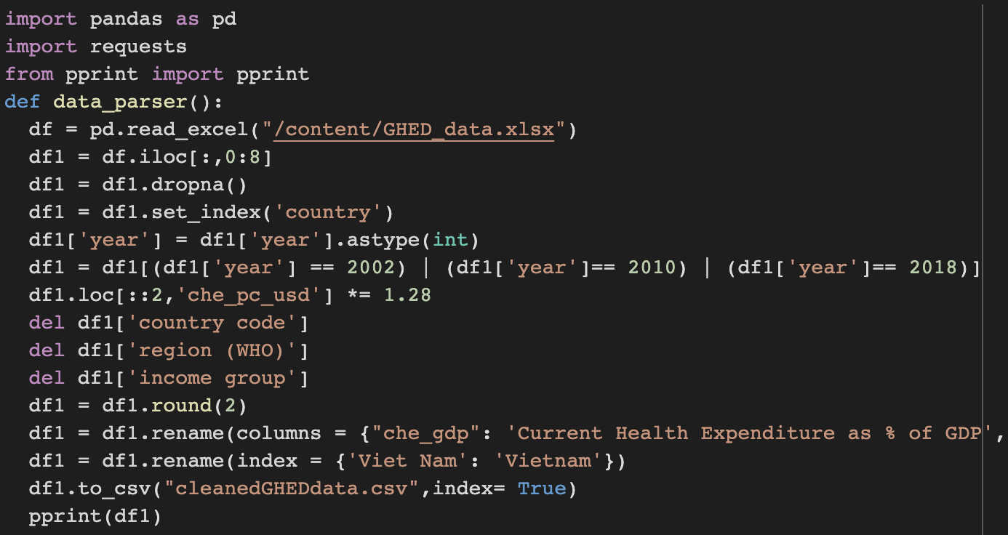
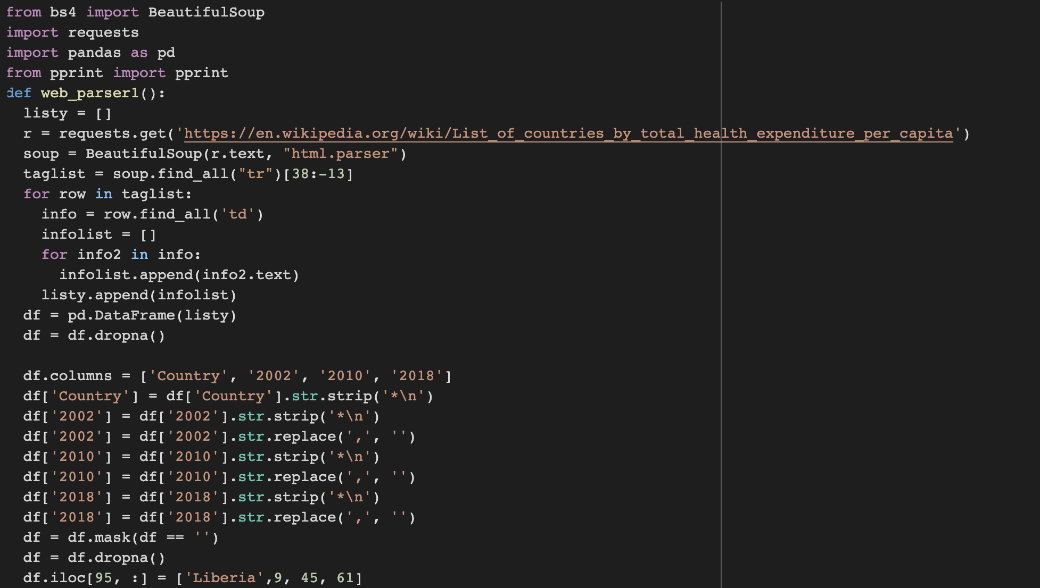
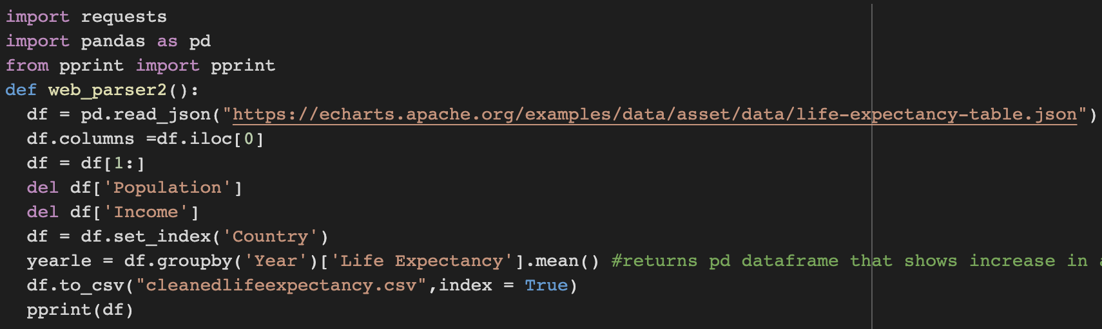
Data Collection and Data Cleaning
Our data came from:
Echarts.apache.org
Apps.who.int
Wikipedia Table
How we found our sources:
We wanted to find large databases with Healthcare Expenditure Data and also Life Expectancy Data, so we looked at major organization websites and Online databases to find our sources, like Echarts and the WHO database.
Modules used for Collection and Cleaning:
Requests, Pandas, BeautifulSoup, PPrint

Slide 4
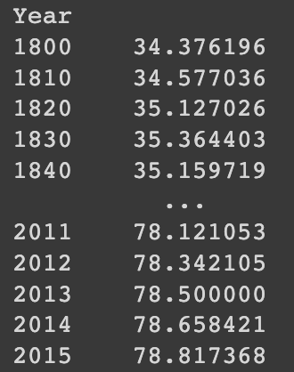
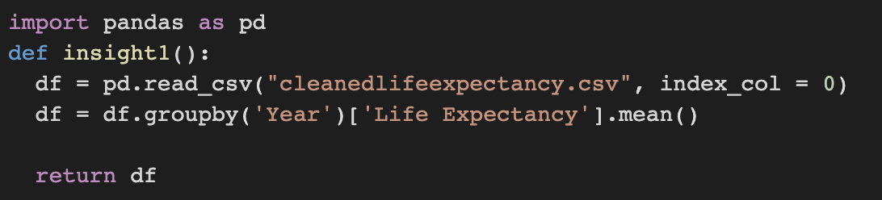
Insight 1
Looks into how Average Life Expectancy as a whole around the world has increased or decreased over a couple centuries.
Allows us to track and find a trend in Average Life Expectancy in all nations and also allows us to compare it with the trends found in Healthcare Expenditure

Slide 5
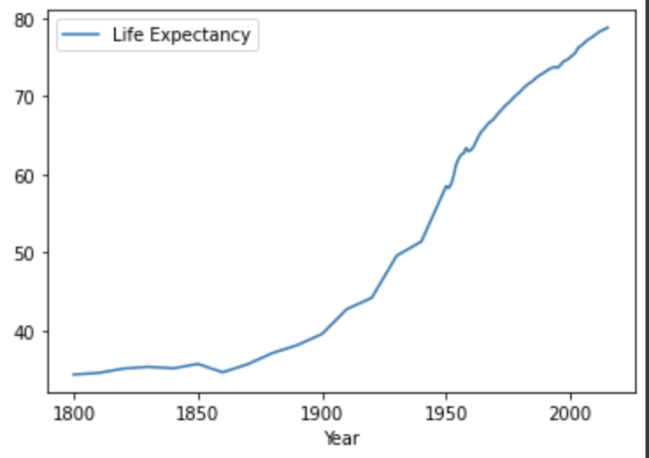
Visualization 3
Visualization 3 links with insight 1, as the line graph shows us how Average Life Expectancy changes throughout the years, and how it can link with Healthcare Expenditure over time.

Slide 6
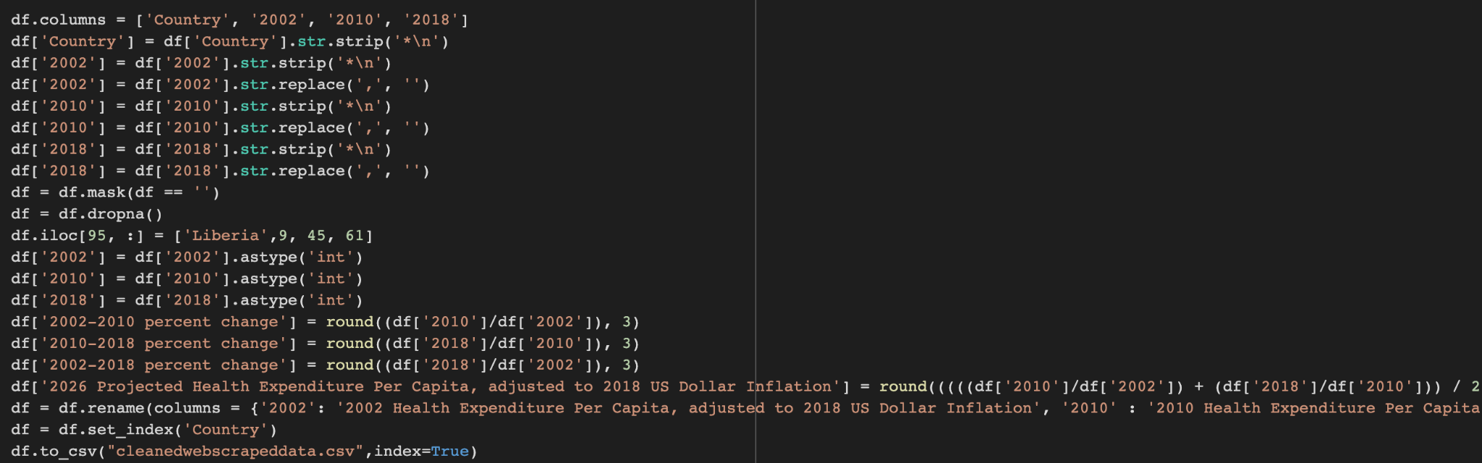
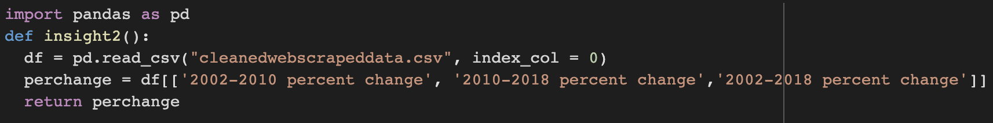
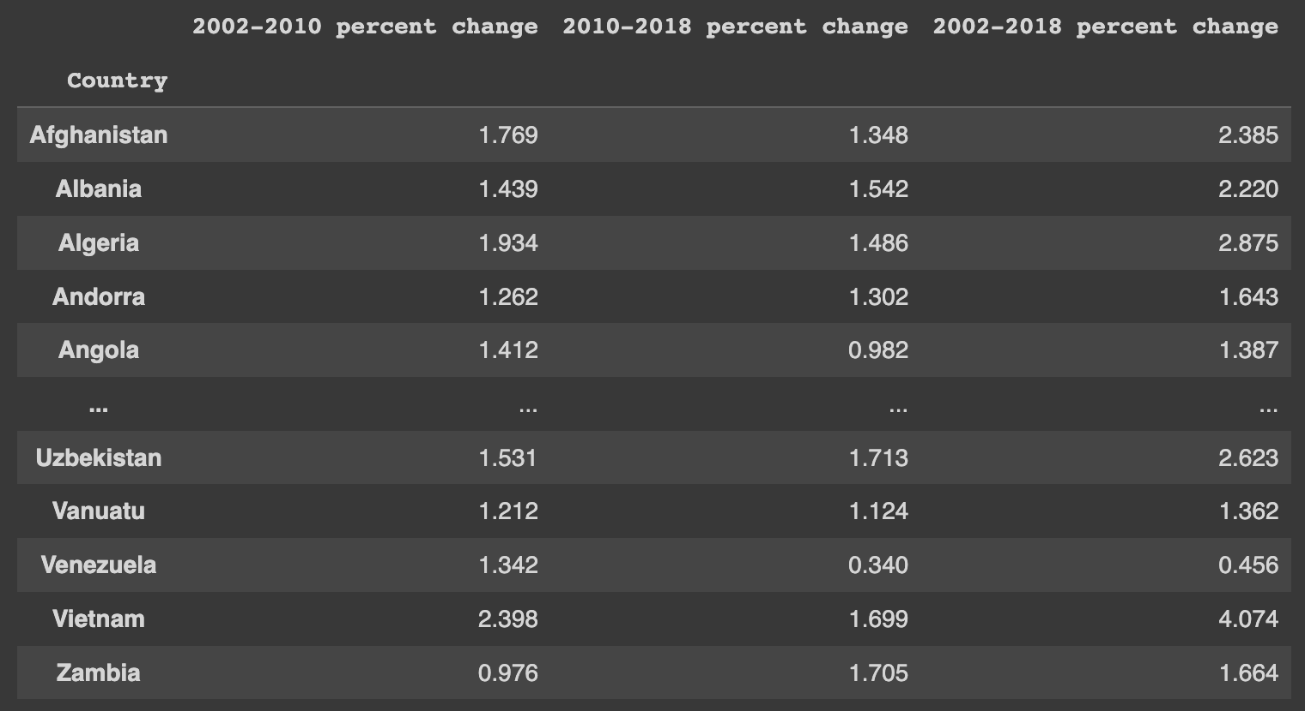
Insight 2
Insight two focuses on a percent change calculation to see how nations from 2002-2018 have changed their Healthcare Spending Per Capita.
This allows us to tracks trends in how nations have been changing their HSPC and looking at the overall trend through the years.

Slide 7
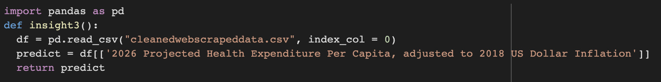
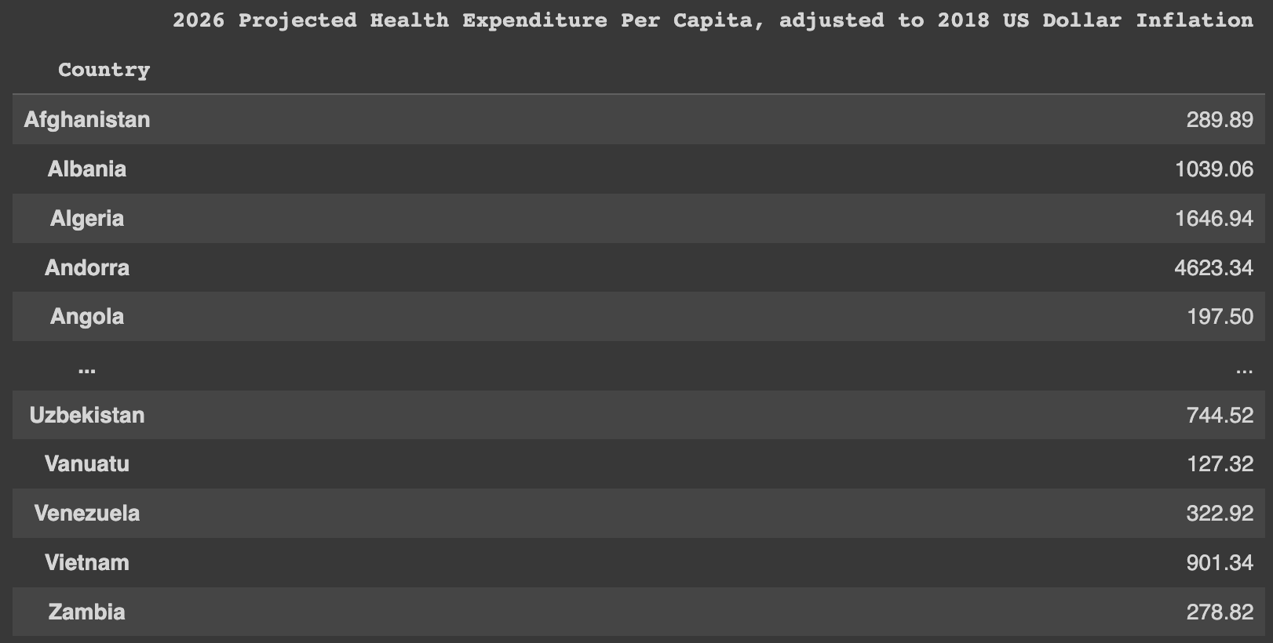
Insight 3
Insight 3 is a predictive calculation
The purpose is to predict how nations will spend on Healthcare Per Capita in 2026.
Many nations seem to have an increase in HSPC as the trend shows an overall increase towards 2026

Slide 8
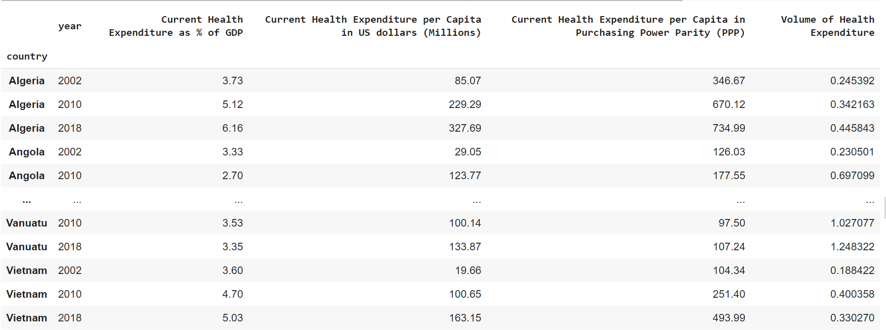
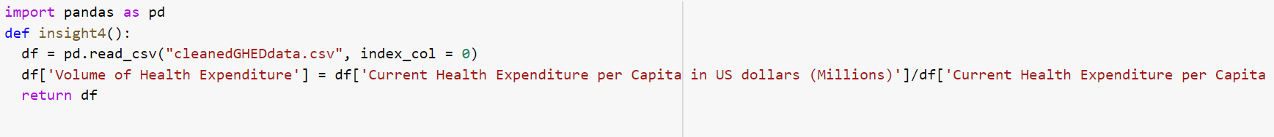
Insight 4
DIviding the PPP by the Health Expenditure examines the buying power of each country.
Buying power looks for a correlation between whether countries are spending enough and whether an improvement on spending increases life expectancy.

Slide 9
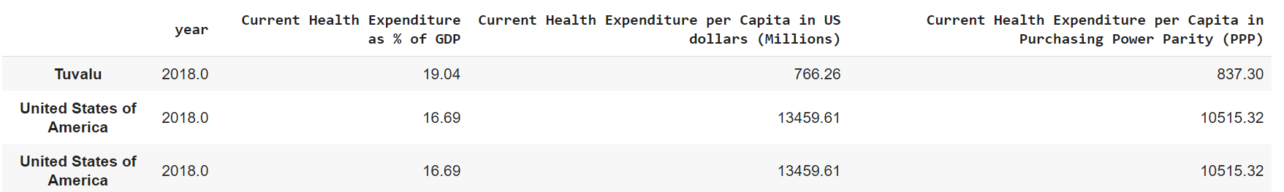
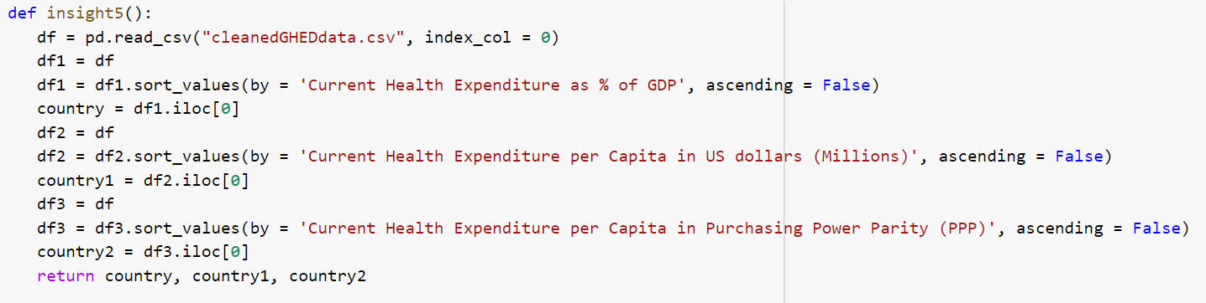
Insight 5
Explores which countries spend the most compared to which country allocates the most based on ratio
Allows us to see how countries’ life expectancy are doing based on size of government and population

Slide 10
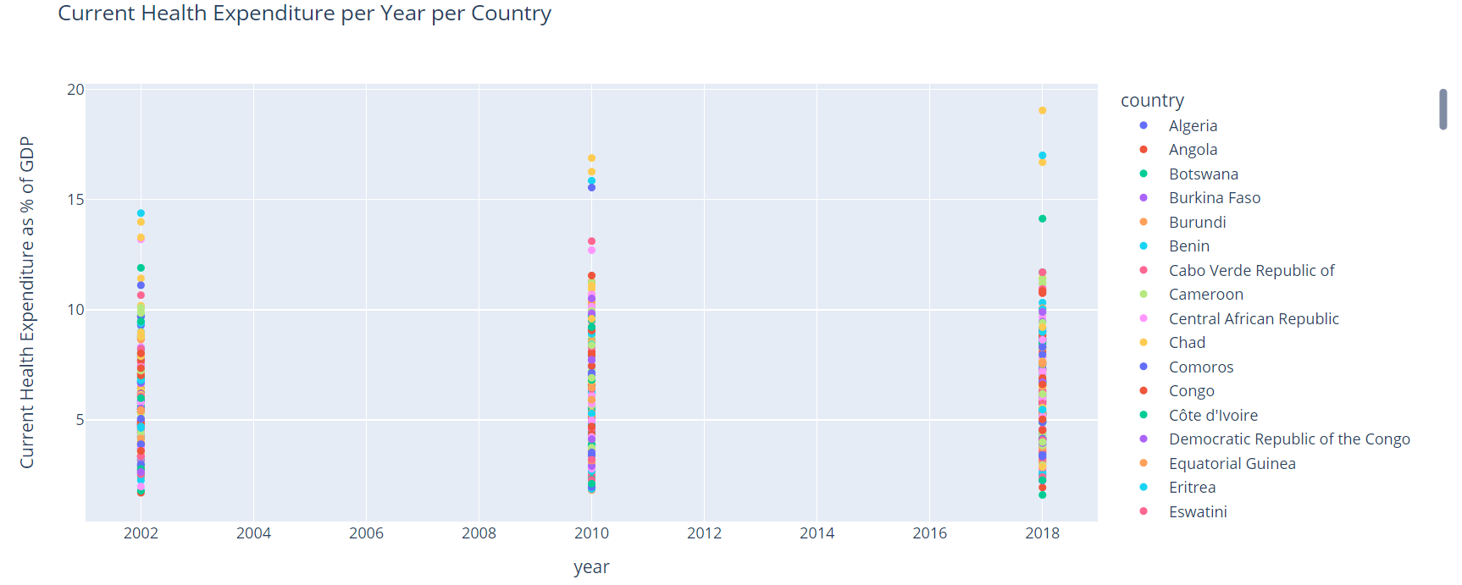
Visualization 1

Slide 11

Visualization 1
The graph gives us an idea of which countries tend to put health expenditures as a high priority and see how the priority of health expenditures has changed per country through the years. This data can also help see if the countries' life expectancy has improved or decreased based on if they increased or decreased the amount of money they spend on health expenditures.

Slide 12
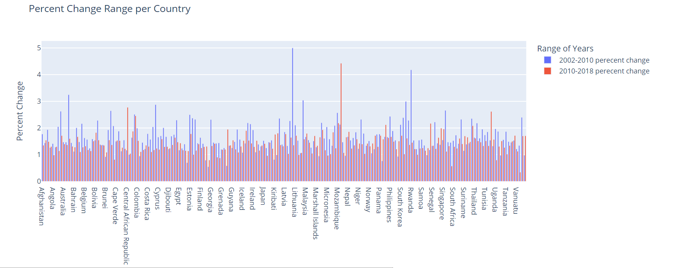
Visualization 2

Slide 13
Visualization 2
The bar graph represents 2 bars per country: percent change from 2002 to 2010 and percent change from 2010 to 2018 respectively.
Helps us visualize who has improved the most in health care expenditure and identify whether this increase has paid off in terms of improving life expectancy.

Slide 14
Results and Conclusion
For each country, the general correlation of life expectancy from 1800 to present is a constant increase (Australia in 1800 - 34.05, 1920 - 60.51, 2018 - 81.8). This increase could have been as a result of many factors such as improvement in hygiene and technology, decrease in birth rate etc. We wanted to examine whether a country’s change in health expenditure has a direct correlation in their life expectancy. We examined the health expenditure for multiple countries and their trends through the years and compared this to the trends of life expectancy for the same countries. We found that the relationship is true for every country that we examined.

Slide 15
Thank you for watching!

